Slide 1

Sujets d’actualité
Dynamique moléculaire et réactivité des plasmas. Application à la dégradation des polluants organiques dans l’eau.
Pascal Brault
GREMI, UMR7344 CNRS Université d’Orléans, Orléans, France

Slide 2
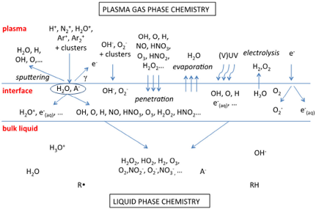
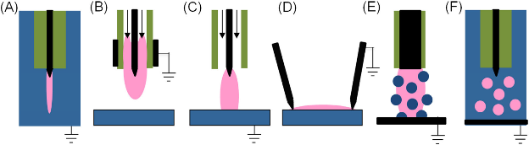
Plasma (NTPA, CAP) degradation of organic pollutants in water
Within the scope of plasma-liquid interactions
Non Thermal Plasma at Atmospheric Pressure (NTPA) is creating oxidizing species (RONS) expected to interact with organic pollutant in water
  Efficiently degrade the parent molecule to non-toxic products
  Optimize (plasma) process: requires knowledge of oxidation chemistry in water : reactants, reaction products, pathways and selectivity
    → molecular simulations ?
M Magureanu et al, A review on non-thermal plasma treatment of water contaminated with antibiotics, J Haz. Mat. 417 (2021) 125481
P Vanraes and A Bogaerts, “Plasma physics of liquids—A focused review”, Appl. Phys. Rev. 5, 031103 (2018).
P J Bruggeman et al, Plasma–liquid interactions: a review and roadmap, Plasma Sources Sci. Technol. 25 (2016) 053002
Samukawa S et al, The 2012 plasma roadmap, J. Phys. D: Appl. Phys. 45 (2012) 253001

Slide 3
Molecular dynamics implementation
Water + oxidant molecules/radicals + organic pollutant
  But which composition since pollutant fraction is ranging from 1 ng/L to 100 mg/L ?
  Which ratio of oxidant radicals ?
  At this stage 100 H₂O + 10 OH (or …) + 1 pollutant molecule
Finding possible products
  Temperature ramp: 300 K - 3500 K → hierarchy of product formation
  Conversely → Product prediction and associated energetics
Major drawback: no electron → role of solvated electron
Lack of reactive forcefields for complex organic pollutants.
  Help of quantum chemistry

Slide 4

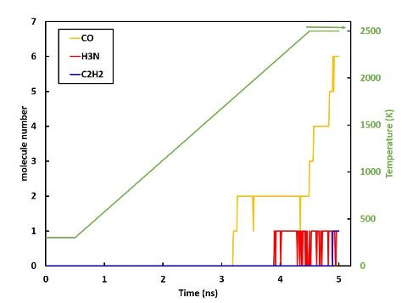
Case study #1: Paracetamol
100 H₂O + 10 HO + 1 C₈H₉NO₂ Exp.→ 6. 10¹⁶ paracetamol cm⁻³ / HO 10¹⁸ cm⁻³
Reactive force field ReaxFF: O. Rahaman et al, J. Phys. Chem. B 115, 249 (2011)
dt = 0.1 fs; Nit = 5 10⁷ itérations; Nosé-Hoover Thermostat 𝛕 = 100 fs; Temperature ramp : 0.55 K.ps⁻¹
Initial configuration
Final configuration (5 ns)
Final products: 6 CO, 1 C₂H₂, 1 NH₃, 103 H₂O, 1 H₂, 1 H₃O
P. Brault, M. Abraham, A. Bensebaa, O. Aubry, D. Hong, H. Rabat, M. Magureanu, Insight into plasma degradation of paracetamol in water using a reactive molecular dynamics approach, J. Appl. Phys 129 (2021) 183304

Slide 5
Case study #1: Paracetamol
Intermediate products
  Consistency: compare products at a given temperature during ramping and with constant temperature
  At 1600 and 2500 K they are the same : 2 CO at 1600K and 6 at 2500 K → ramping rate is ok.
  [HO•] decreases very quickly, and some others are created during the ramping
  no stable H₂O₂ are created, only intermediate specie (problem with ReaxFF ?)
Relevance
  A well parametrized forcefield is required. ReaxFF unfortunately is not highly transferable at present
  NOx formation not predicted by ReaxFF
  Intermediate products are not fully relaxed and thus immediate comparison with experiments is difficult
Is Quantum Chemistry coupling with MD, a relevant way ?

Slide 6
Quantum Chemistry and MD
For geometry optimization of pollutants molecules and basic data (Mulliken charges, bond lengths and angles, electronic levels, IR frequencies, ionization potential, electron affinity, etc)
For calculating and sorting all internal bond energies of pollutant molecules
  Identifying weakest bonds thus able to break efficiently
  When surrounded with water and active species, checking bond energy evolution: weakening vs tightening.
Ab-Initio Molecular Dynamics → for solving Newton equations of motion, the interaction potentials can be calculated using quantum methods, such as Hartree-Fock, Hückel, DFT(B), etc
  Necessary if bond-order reactive semi-empirical potentials are not available for MD simulations
  Taking account of electron processes (charge transfer, etc)
  But at the expense of increasingly computing time → Relevant Modeling

Slide 7
Quantum Chemistry and MD
What is the goal of quantum chemistry ?
  Classical MD → atoms are points subjected to forces possibly included charge effects through Coulomb forces
  Solving Schrödinger equation including electrons
    But 1 nucleus = 1 electron for H but 6 for C, 7 for N, 8 for O, and 16 for S
    So full electrons calculations of the interaction potentials becomes almost unfeasible
Thus, Density Functional Theory (DFT) comes into play
  Hohenberg-Kohn theorem: The full many-particle ground state is a unique functional of n(r)
  There are many assumptions leading to improving computational but more complicated approximations solve more specific problems
  Here Density Functional Theory in the Tight-Binding approach → DFTB (Computationally efficient DFT scheme) → GFN1-xTB parameterization, which is optimized for geometries, frequencies and non-covalent interactions and covers all elements of the periodic table up to radon.
Notes:
The efficiency of Slater-Koster based DFTB stems from its use of an optimized minimum valence orbital basis that reduces the linear algebra operations, and a two center-approximation for the Kohn-Sham potential that allows precalculation and storage of integrals using the Slater-Koster technique. This makes DFTB orders of magnitude faster than DFT, but requires parameter files (containing the integrals) for all pair-wise combinations of atoms in a molecule. Many elements can be handled with the parameter sets included in the distribution. Alternatively, sets of parameters in the SKF format can be downloaded and used from third party sources.
The extended tight-binding (xTB) model Hamiltonian as recently been introduced by Grimme and coworkers. It makes similar approximations as Slater-Koster based DFTB, but instead of using precalculated integrals, xTB employs a (small) basis of Slater-type orbitals and uses an extended Hückel-like approximation for the Hamiltonian.
The DFTB Engine supports the GFN1-xTB parameterization of xTB, which is optimized for geometries, frequencies and non-covalent interactions and covers all elements of the periodic table up to radon.

Slide 8
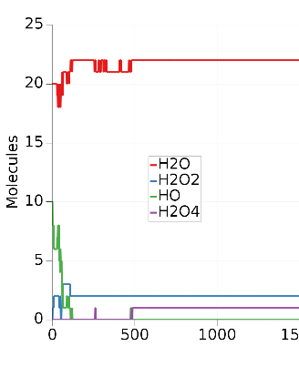
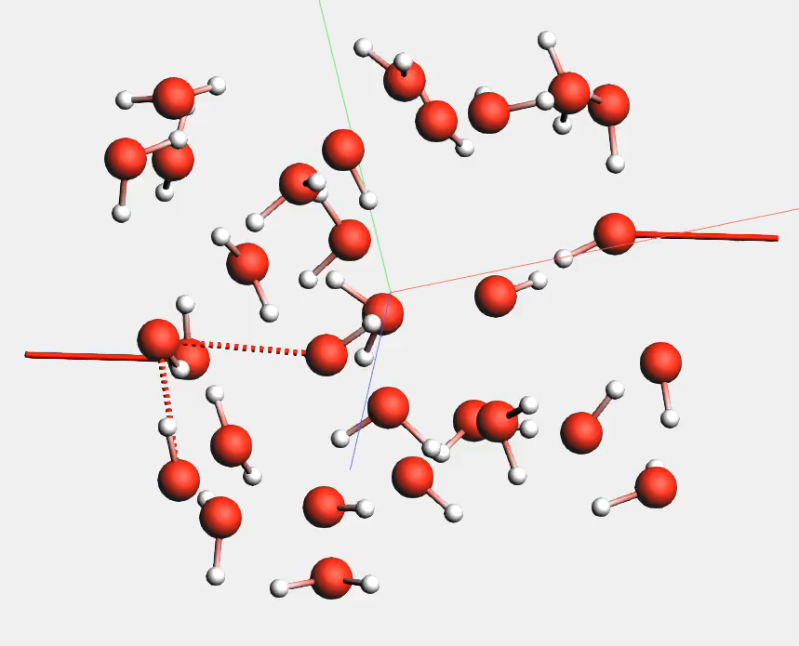
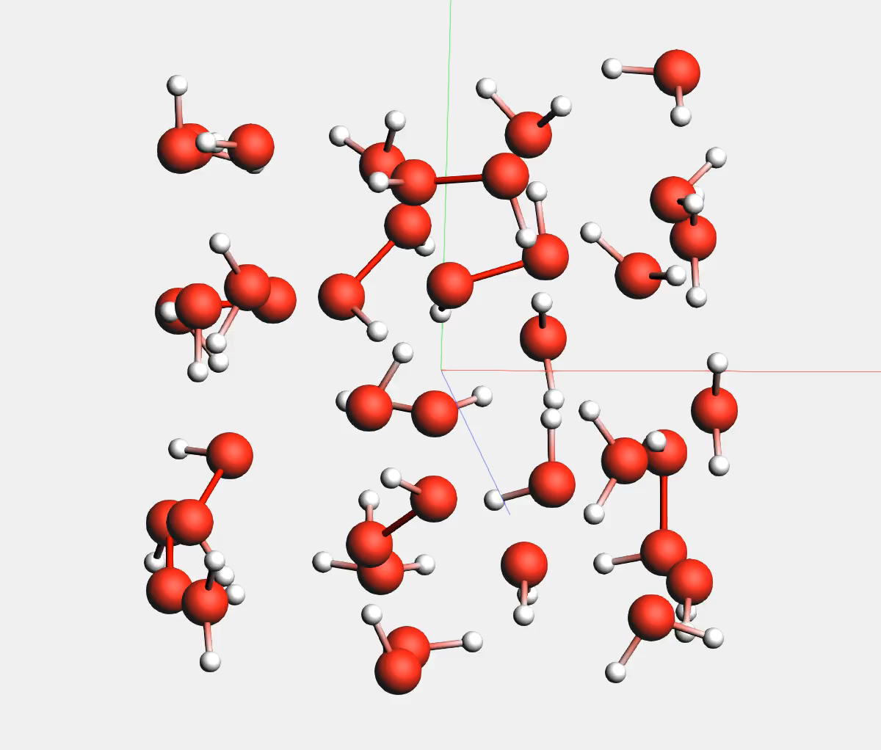
DFTB-MD (GFN1-xTB parameterization): preliminaries
10 HO + 20 H₂O
→HO quickly reacts
10 H₂O₂ + 20 H₂O
→ very stable
H₂O: 20 → 22
HO: 10 → 0
H₂O₂: 0 → 2
HO—O-O—OH: 0 → 1
300K, dt = 0.25 fs; Nosé-Hoover thermostat

Slide 9
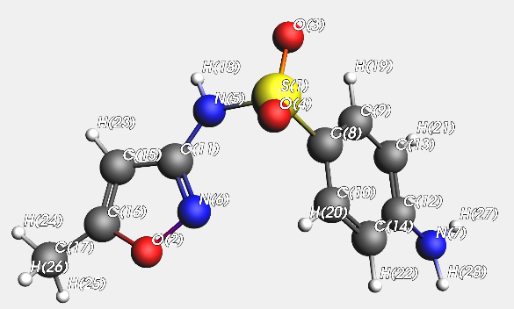
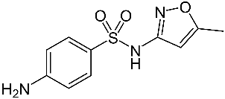
Case study #2: Sulfamethoxazole (SMX)
Sulfamethoxazole
C₁₀H₁₁N₃O₃S
Antibiotics → Widely used for animal breedings and human care
No reactive FF (S-N bond) → DFTB - MD
(PHC BRANCUSI → Collaboration Uni Bucharest/INFLPR)

Slide 10
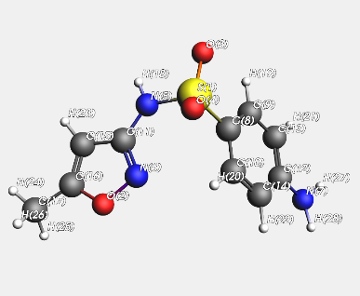
Case study #2: Sulfamethoxazole (SMX)
Energy Decomposition Analysis (EDA): Calculation of all bond energies in a molecules. Using Internal Quantum Atom (IQA) method, it is now possible to establish, if the interaction between two atoms is energetically stabilizing or not, and to conclude about its nature (electrostatic, covalent, etc.).
Sulfamethoxazole isolated and with H₂O (1g.cm⁻³)
bond | No H₂O | With H₂O | Variation (%)
S1-O3 | -2.046 | -1.993 | -2.6
S1-O4 | -2.053 | -1.97 | -4.0
S1-N5 | -1.352 | -1.588 | 17.5
S1-C8 | -0.38 | -0.37 | -2.6
N5-C11 | -0.711 | -0.726 | 2.1
N5–H18 | -0.455 | -0.291 | -36.0
N6-C11 | -0.576 | -0.586 | 1.7
N6-O2 | -0.304 | -0.289 | -4.9
N7-C12 | -0.59 | -0.539 | -8.6
N7-H28 | -0.427 | -0.419 | -1.9
C15-C16 | -0.379 | -0.378 | -0.3
C15-H23 | -0.241 | -0.231 | -4.2
C16-C17 | -0.286 | -0.286 | 0.0
O2-C16 | -0.587 | -0.584 | -0.5
IP = 7.747 eV
EA = -0.968 eV
V. Tognetti and L. Joubert, On the physical role of exchange in the formation of an intramolecular bond path between two electronegative atoms, Journal of Chemical Physics 138, 024102 (2013)

Slide 11
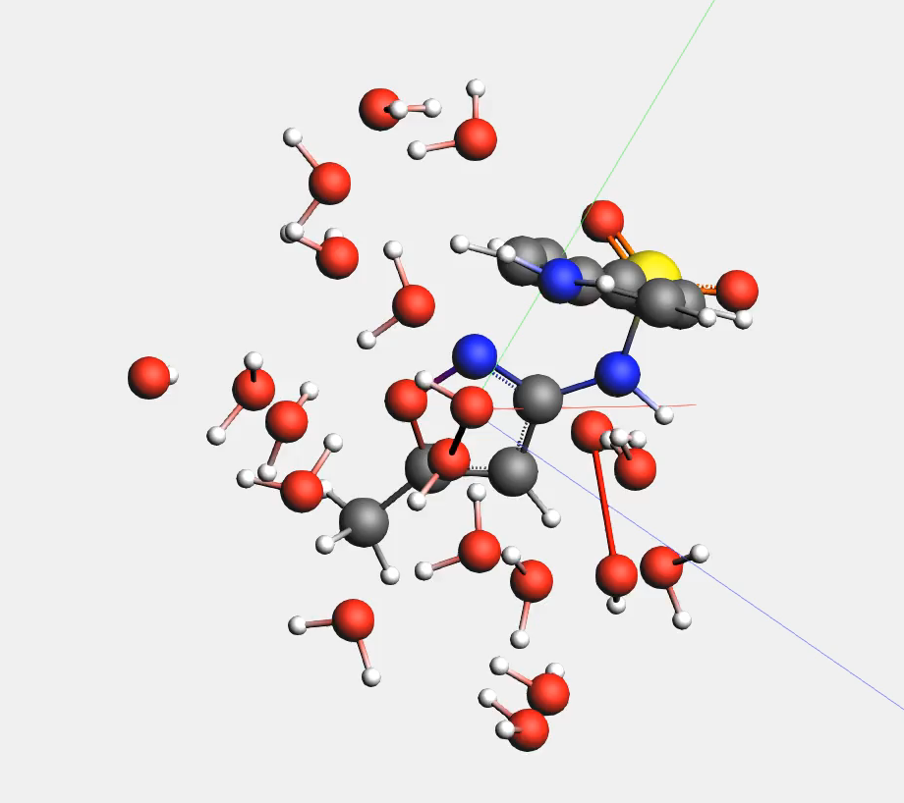
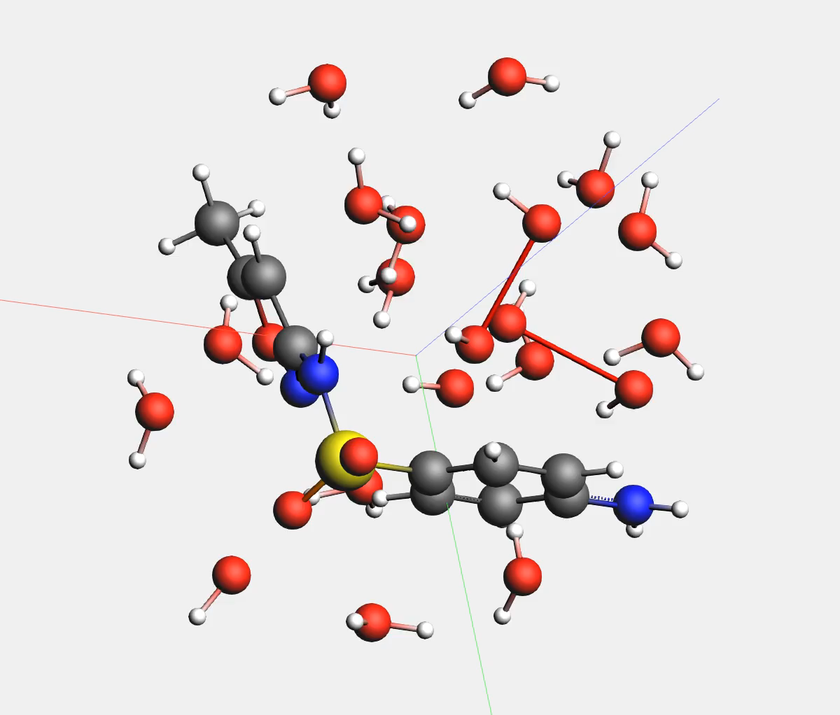
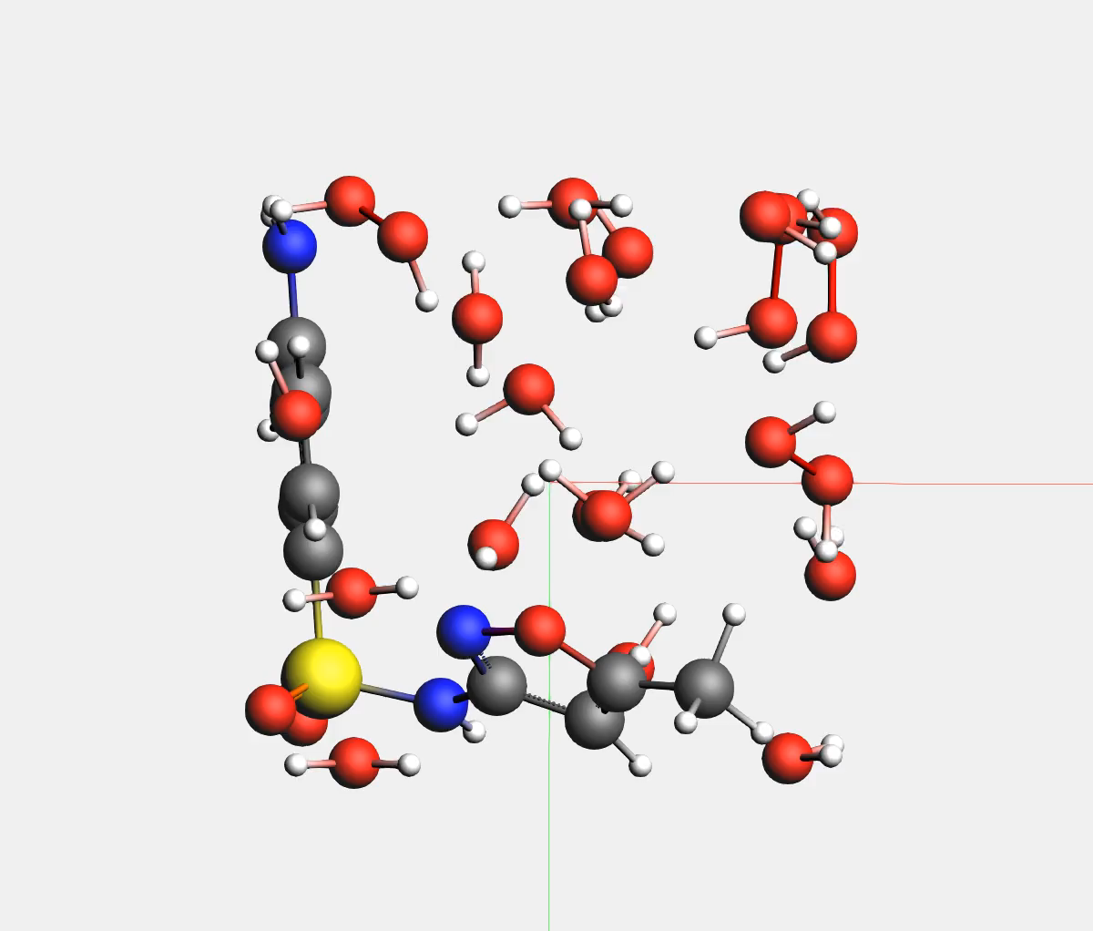
Case study #2: Sulfamethoxazole (SMX)
15 H₂O + 5 HO + 1 SMX (1g.cm⁻³)
15 H₂O + 4 H₂O₂ + 1 SMX (1g.cm⁻³)
300 K
500 K
300 K & 500 K
HO---OH + OH → H2O + HOO
/C
HOO + SMX → HOO-CH
\C
HO---OH + C(SMX) → O-SMX + H₂O
/ C
O → -C-O-C
\C
Nothing happens
→ HO et HO---OH are responsible of bond formation

Slide 12
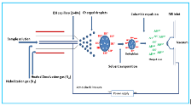
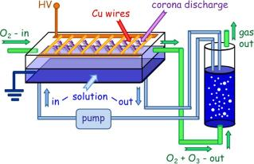
Case study #2: Sulfamethoxazole (SMX)
Sulfamethoxazole degradation in NTPA experiment (at short time)
  Electrospray ionization tandem mass spectrometry (+/- ESI-MS/MS) experiments
  (M. Magureanu , C. Bradu, F. Bilea)
EDA calculations consistent with OH interaction places → Weaker bonds
DFTB-MD products at 300K (?) and 500K consistent with P269b/c (+/- ESI) products

Slide 13
Conclusions & Future work
Conclusions
Molecular simulations can provide insights into oxidation process of plasma degradation of organic pollutants in water -> OH interaction with SMX using DFTB + MD → HO---OH
Availability of high-resolution analysis of degradation products allows comparison with simulation predictions.
Future work
High throughput DFTB-MD for unravelling reaction pathways of a large set of pollutants and direct comparison to NTPA experiments
-> Amoxicillin, glyphosate and Endocrine Disruptor Chemical (EDCs).
Inclusion of electrons using eReaxFF/DFT-MD → solvated electron effect ?
Campus France is gratefully acknowledged for the FRANCE – ROMANIA grant PHC BRANCUSI 2019 No. 43505RC.

Slide 14

Dynamique Moléculaire : Principes et Méthodes
Merci de votre attention

